Slide 1
Front End Web Development
Topic 10: Responsive CSS Framework:
BootStrap - II
Notes:
NCC Education - Title Master

Slide 2
Scope and Coverage
This topic will cover:
Bootstrap Forms
Bootstrap Form Controls
Bootstrap Buttons
Bootstrap Utilities
Bootstrap Cards
Notes:
NCC Education - Slide Master

Slide 3
Learning Outcomes
By the end of this topic students will be able to:
Use advanced features of Bootstrap and develop responsive web pages
Demonstrate understanding of various bootstrap concepts including Bootstrap form, form controls, buttons, utilities and Cards
Identify different types of Bootstrap elements and explain its working

Slide 4
Unit Roadmap
Week | Topic | Week | Topic
1 | Overview of Web Application Architecture | 7 | JavaScript - II
2 | Introduction to HTML5 | 8 | jQuery
3 | Introduction to CSS | 9 | Responsive CSS Framework: Bootstrap - I
4 | HTML and CSS | 10 | Responsive CSS Framework: Bootstrap - II
5 | CSS Flexbox and Grid Layout | 11 | Code Review, Testing and Collaboration
6 | JavaScript - I | 12 | Unit Summary

Slide 5
Bootstrap components

Slide 6
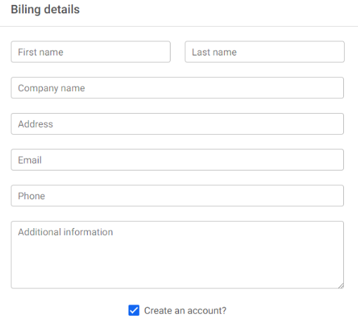
Forms
Form controls automatically receive global styling in Bootstrap:
All Textual <input>, <textarea>, and <select> elements with class .form-control have a width of 100%
Form Layouts:
Bootstrap provides following types of layouts:
Vertical (default) form
Inline form
Horizontal form

Slide 7
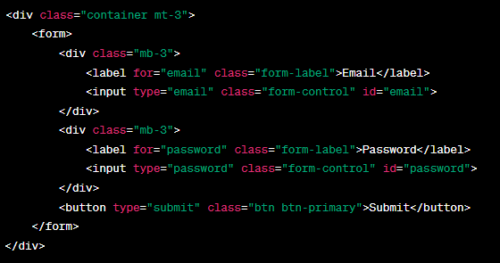
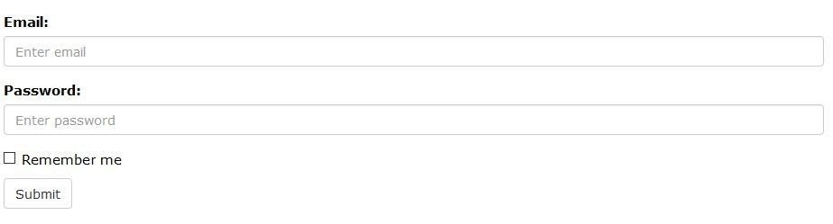
Vertical (default) Forms
Wrap labels and controls in a <div> with class .form-group for optimum spacing.
Add a class of .form-control to all textual <input>, <textarea>, and <select> elements.

Slide 8
Inline Forms
All elements are inline, left aligned and labels are alongside using the class .form-inline to the <form> tag.
Note: Only applies to forms within viewports at least 768px wide
<div class="container mt-3">
<form class="form-inline">
<input type="email" class="form-control mb-2 mr-2" id="email" placeholder="Email">
<input type="password" class="form-control mb-2 mr-2" id="password" placeholder="Password">
<button type="submit" class="btn btn-primary mb-2">Submit</button>
</form>
</div>

Slide 9
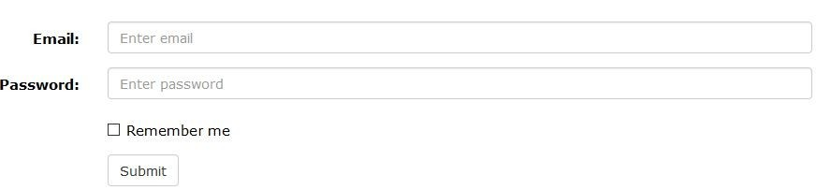
Horizontal Forms
Add a class of .form-horizontal to the parent <form> element.
Add a class of .control-label to all <labels> elements.
<div class="container mt-3">
<form class="form-horizontal">
<div class="form-group">
<label for="email" class="control-label col-sm-2">Email</label>
<div class="col-sm-10">
<input type="email" class="form-control" id="email" placeholder="Email">
</div>
</div>
<div class="form-group">
<label for="password" class="control-label col-sm-2">Password</label>
<div class="col-sm-10">
<input type="password" class="form-control" id="password" placeholder="Password">
</div>
</div>
<div class="form-group">
<div class="col-sm-offset-2 col-sm-10">
<button type="submit" class="btn btn-primary">Submit</button>
</div>
</div>
</form>
</div>

Slide 10
Quiz - 1
Describe the differences between the different types of forms in Bootstrap

Slide 11
Bootstrap form controls

Slide 12
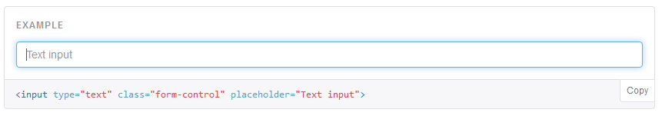
Supported Controls
Inputs:
Bootstrap supports all the HTML5 input types:
text, password, datetime, datetime-local, date, month, time, week, number, email, url, search, tel, and color.
Inputs will be fully styled if type is properly declared.
Textarea: Form control supports multiples lines of text. Change rows attribute as required.
Checkboxes and Radio Buttons: Checkboxes or Radiobuttons are used if you want the user to select any number of options from a list of preset options.

Slide 13
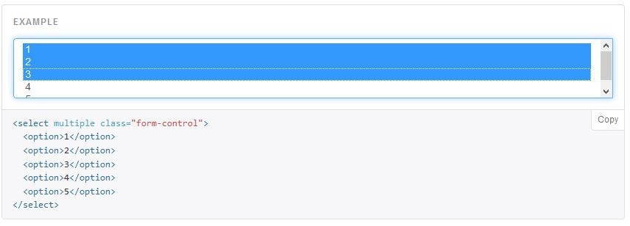
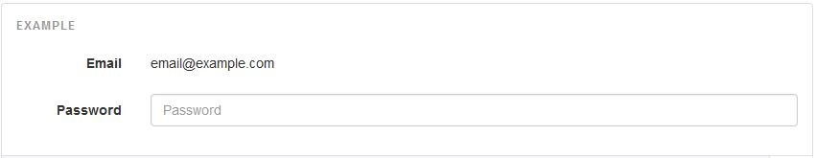
Static Control
Select lists that are allow the user to pick from multiple options.
Static Control :If you need to insert plain text next to a form label within a horizontal form, use the .form-control-static class on <p> element.

Slide 14
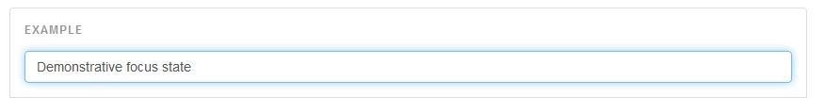
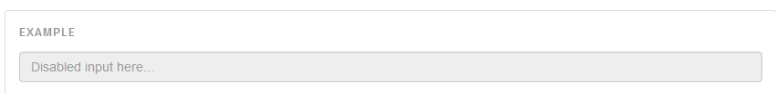
Control States
Focus state : Removes the default outline styles on some form controls and apply a box- shadow in its place for :focus.
Disabled state: Add the disabled Boolean attribute to an input. Disabled inputs appear greyed-out and do not-allow cursor.
Syntax: <input class="form-control" id="disabledInput" type="text" placeholder="Disabled input here..." disabled>

Slide 15
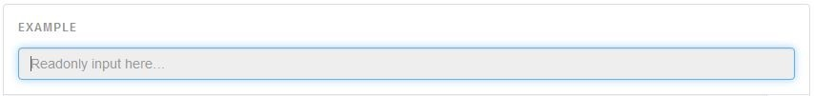
Control States
Readonly state: the readonly Boolean attribute on an input to prevent modification of the input’s value. Read-only inputs appear lighter (just like disabled inputs) but retain the standard cursor.
Syntax:
<input class="form-control" type="text" placeholder="Readonly input here…" readonly>
Help Text: A block of help text that breaks onto a new line and may extend beyond one line.
Syntax:
<label class="sr-only" for="inputHelpBlock">Input with help text</label>
<input type="text" id="inputHelpBlock" class="form-control" area described by="helpBlock">.

Slide 16
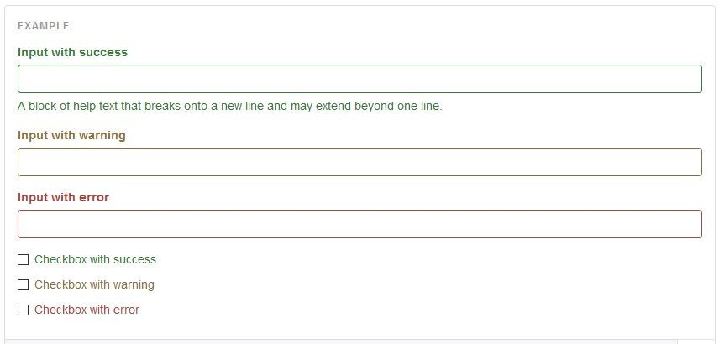
Validation States
Bootstrap includes validation styles for error, warning, and success states on form controls
To use, add .has-warning, .has-error, or .has-success to the parent element. Any .control-label, .form-control, and .help-block within that element will receive the validation styles.

Slide 17
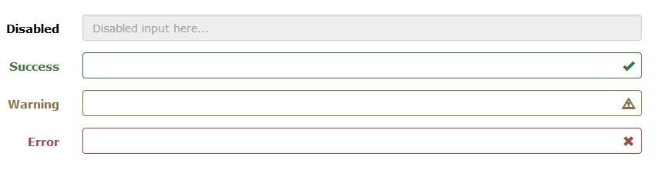
Bootstrap Form Control States - Summary
INPUT FOCUS - Outline of input removed and box-shadow is applied on focus
DISABLED INPUTS - Add a disabled attribute to disable an input field
DISABLED FIELDSETS - Add a disabled attribute to a fieldset to disable all controls within
READONLY INPUTS - Add readonly attribute to an input to prevent user input
VALIDATION STATES - Bootstrap includes validation styles for error, warning, and success messages. To use, add .has-warning, .has-error, or .has-success to the parent element

Slide 18
Quiz - 2
Describe why form controls are needed.
Why are validation states useful in web-design?

Slide 19
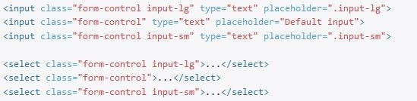
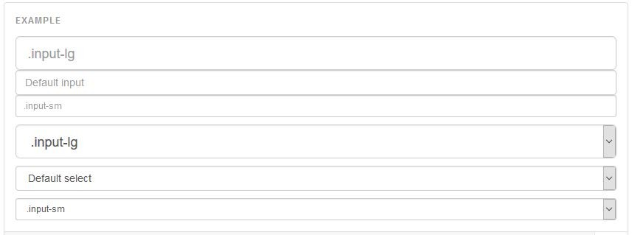
Control Sizing
Set the heights of the input elements using classes likes .input-lg and .input-sm.
Set the widths of elements using grid column classes like .col-lg-* and .col-sm-*.
Height Sizing:

Slide 20
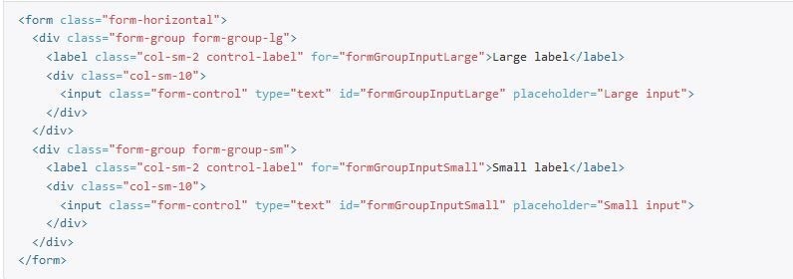
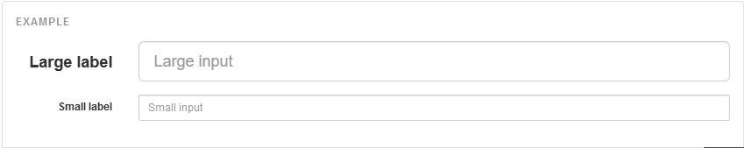
Control Sizing
Horizontal form group sizes:
Size labels and form controls within .form-horizontal by adding .form-group-lg or .form-group-sm.

Slide 21
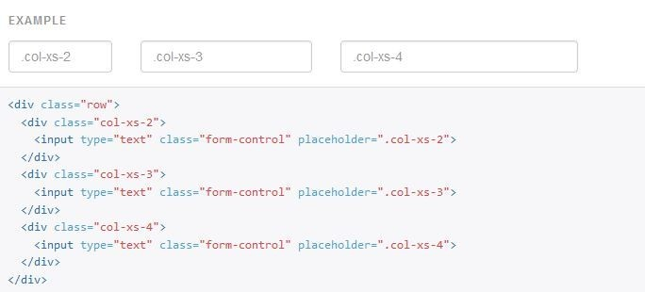
Control Sizing
Column sizing:
Wrap inputs in grid columns, or any custom parent element, to easily enforce desired widths.

Slide 22
Bootstrap buttons

Slide 23
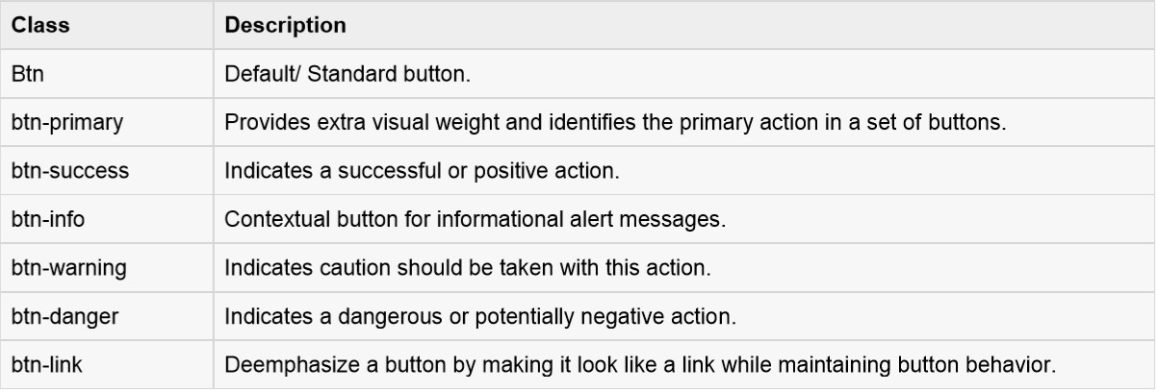
Buttons
By default, in bootstrap, a button given by a class of .btn will inherit the default look of a gray button with rounded corners.
Some of the button elements are in the table:

Slide 24
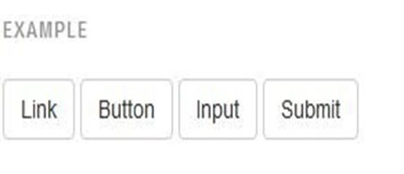
Buttons Tags
Button Tags
The button classes used as <a> ,<button> or <input> element.
Syntax:
<a class="btn btn-default" href="#" role="button">Link</a>
<button class="btn btn-default" type="submit">Button</button>
<input class="btn btn-default" type="button" value="Input">
<input class="btn btn-default" type="submit" value="Submit">

Slide 25
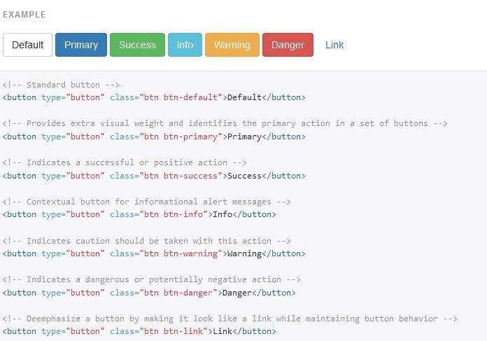
Buttons Options
Bootstrap provides seven styles of buttons:

Slide 26
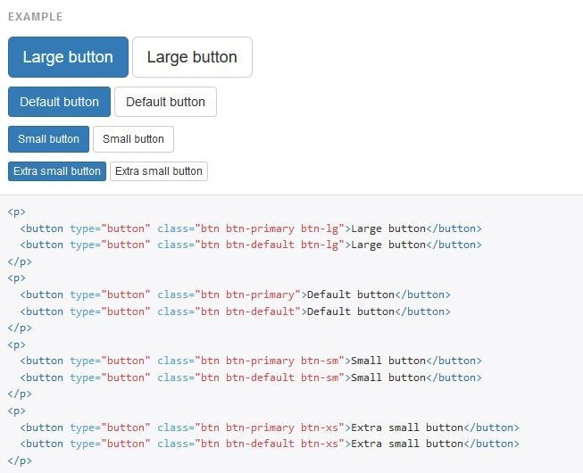
Button Sizes
The classes that define the different sizes are:
.btn-lg
.btn-md
.btn-sm
.btn-xs

Slide 27
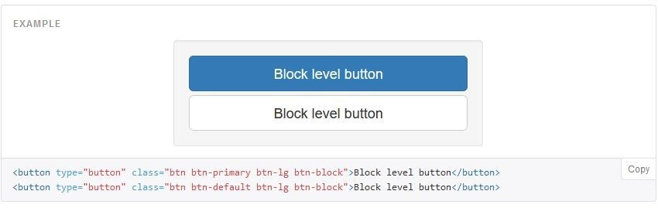
Block-level Buttons
Block level buttons
Buttons that span the full width of a parent— by adding .btn-block.

Slide 28
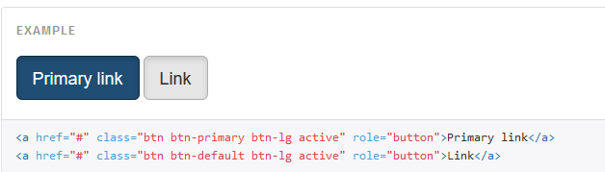
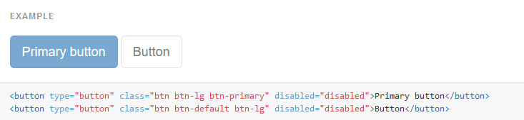
Button States
Active state:
Buttons will appear pressed (with a darker background, darker border, and inset shadow) when active. For <button> elements, this can be done by .active class.
Disabled state:
Make buttons look unclickable by fading them back with opacity.
Add the disabled attribute to the <button> buttons.

Slide 29
Bootstrap utilities

Slide 30
Images
Bootstrap provides three classes that can be used to apply some simple styles to images:
.img-rounded: class adds rounded corners to an image (IE8 does not support rounded corners)
.img-circle: class shapes the image to a circle (IE8 does not support rounded corners):
.img-thumbnail: class shapes the image to a thumbnail.

Slide 31

Images
Syntax:
<img src="..." alt="..." class="img-rounded">
<img src="..." alt="..." class="img-circle">
<img src="..." alt="..." class="img-thumbnail">

Slide 32
Responsive Images
Responsive images automatically adjust to fit the size of the screen
Create responsive images by adding an .img-responsive class to the <img> tag. The image will then scale nicely to the parent element.
The .img-responsive class applies display: block; and max-width: 100%; and height: auto; to the image
<div class="container mt-3">
<img src="path-to-your-image.jpg" alt="Description of Image" class="img-responsive">
</div>

Slide 33
Helper Classes
Add meaning through text-colors with the classes
Example: | Syntax:
Bootstrap Programming. | <p class="text-muted">...</p>
Bootstrap Programming. | <p class="text-primary">...</p>
Bootstrap Programming. | <p class="text-success">...</p>
Bootstrap Programming. | <p class="text-info">...</p>
Bootstrap Programming. | <p class="text-warning">...</p>
Bootstrap Programming. | <p class="text-danger">...</p>

Slide 34
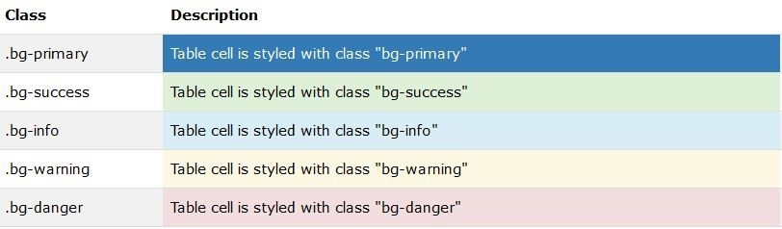
Contextual Backgrounds
Add meaning through background-colors with the classes below.
Links will darken on hover just like text classes:
Syntax:
<p class="bg-primary">...</p>
<p class="bg-success">...</p>
<p class="bg-info">...</p>
<p class="bg-warning">...</p>
<p class="bg-danger">...</p>

Slide 35
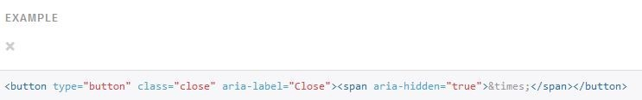
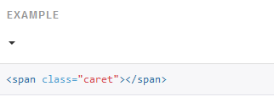
Interaction Controls
Close icon :
Use the generic close icon for dismissing content like modals and alerts. Use the class close to get the close icon.
Carets:
Use carets to indicate dropdown functionality and direction.

Slide 36
Quick Floats
Float an element to the left or right with a class.
<div class="pull-right">...</div>
Center content blocks: Sets an element to display:block and center with margin-right:auto and margin-left:auto.
<div class="center-block">...</div>
Showing and hiding content:
.show class Forces an element to be shown (display:block)
.hidden class Forces an element to be hidden (display:none)
<div class="show">...</div>
<div class="hidden">...</div>

Slide 37
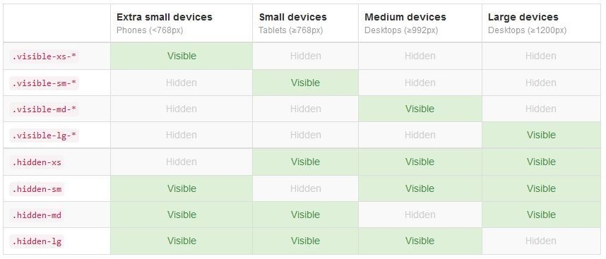
Responsive Utilities
Show and/or hide content by device via media queries.
Available classes :
Use one or a combination of the available classes for toggling content across viewport breakpoints.

Slide 38
Bootstrap cards

Slide 39
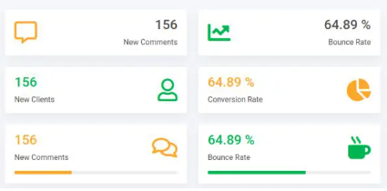
Bootstrap Cards
A card in Bootstrap is a bordered box with some padding around its content.
Unified Design: Consolidate varying content types (images, text, lists) into a single, consistent design.
Flexibility: Multiple sizes, alignments, and styles available. Can contain headers, footers, and various content.
Interactive Components: Incorporate buttons, links, and other interactive elements seamlessly.
Responsive: Adapts to various screen sizes ensuring content is always legible and looks professional.
Customisable: Easy to modify with CSS to match any brand or design aesthetic.

Slide 40
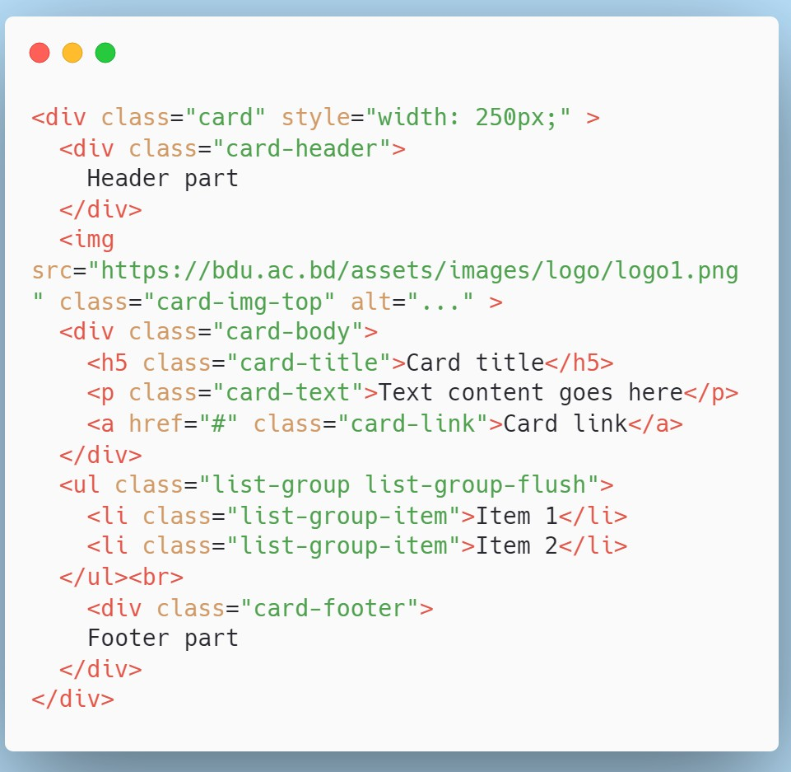
Card Content Type
Content Types: Cards support a wide variety of content, including images, text, list groups, links, and more.
Subcomponents: There are various subcomponents you can include:
card-header: A header section.
card-body: Main content area for short descriptions.
card-title and card-subtitle: Title and subtitle for the content.
card-text: Additional text content.
card-link: Links you can add to a card.
card-footer: A footer section.
card-img-top and card-img-bottom: For placing images at the top or bottom of a card.

Slide 41
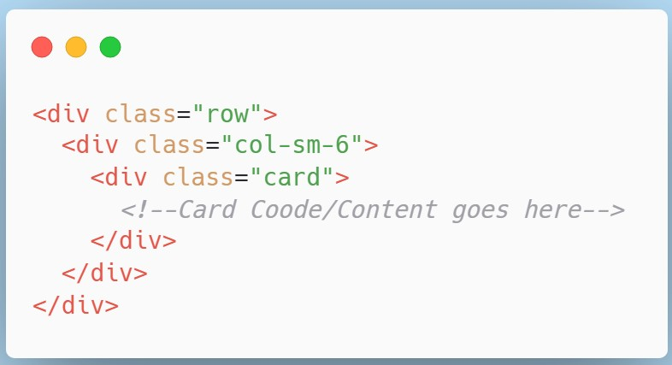
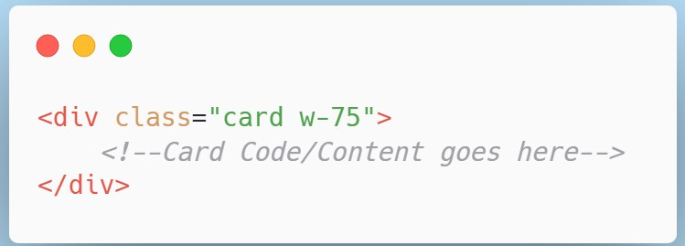
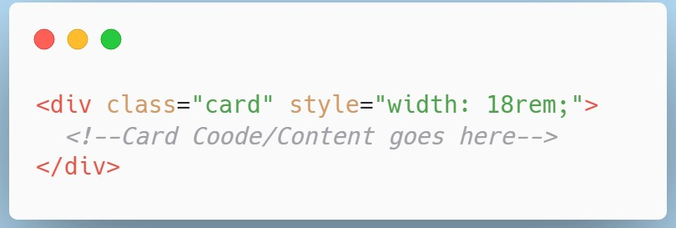
Card Sizing
Sizing and Alignment: There are classes to modify the default look, align content, and stretch or squeeze the cards to make them fit your layout needs.

Slide 42
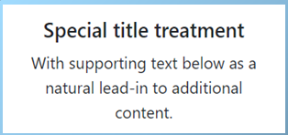
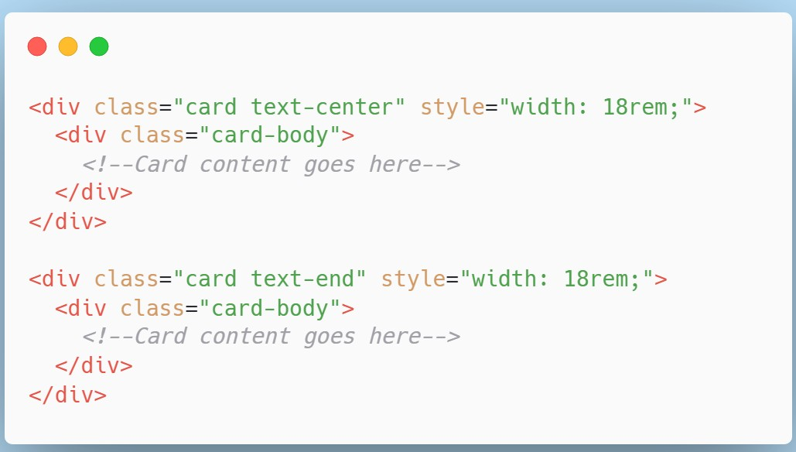
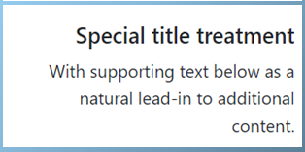
Card Text Alignment

Slide 43
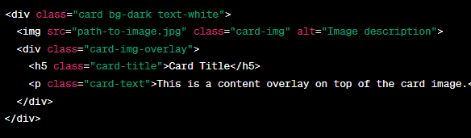
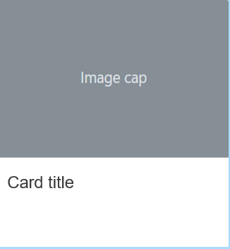

Card Images
The .card-img class is used for adding images to cards
The .card-img class is typically used in conjunction with the .card-img-overlay class to display content on top of the image.

Slide 44
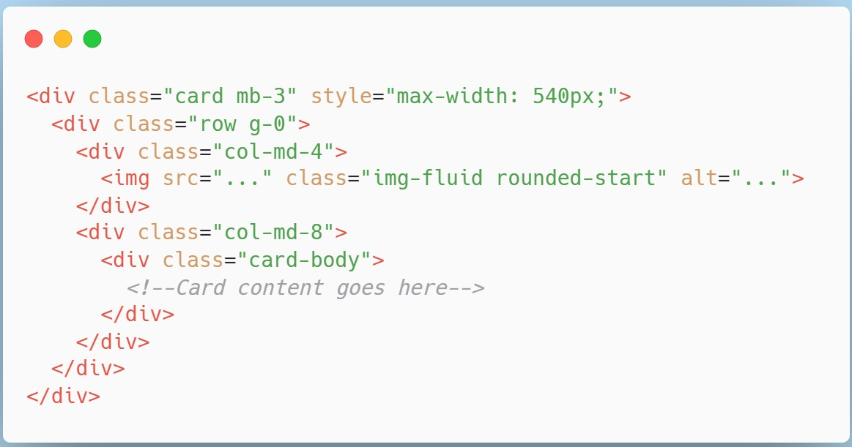

Horizontal Card
A horizontal card layout arranges the card's image and content side by side, as opposed to the traditional top-to-bottom layout.
This can be especially useful for presenting content in a more compact and wide layout, such as in a media object or a list of articles.

Slide 45
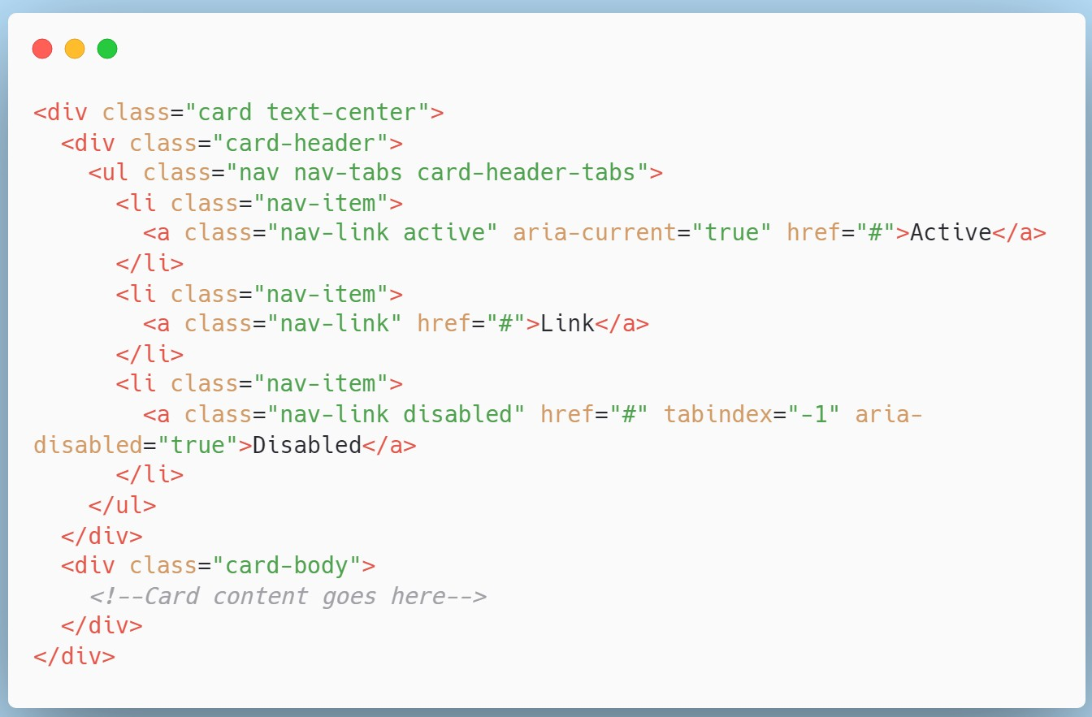
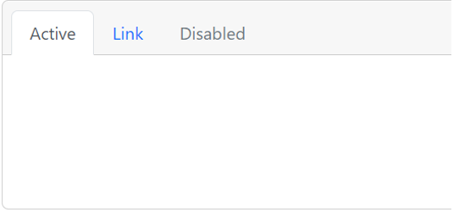
Card Navigation
Card navigation in Bootstrap refers to integrating Bootstrap's navigation components (like tabs or pills) within a card, allowing for a more compact and organised presentation of information.

Slide 46
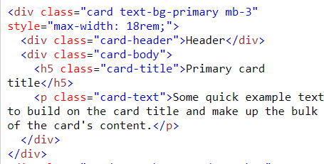
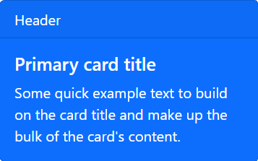
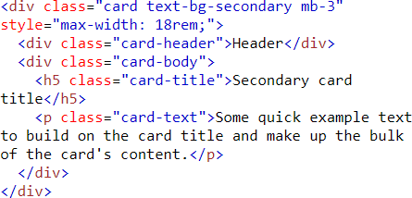
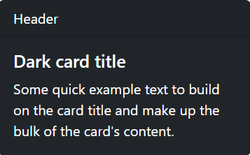
Card Styles
Background and color
Border
Mixins utilities

Slide 47
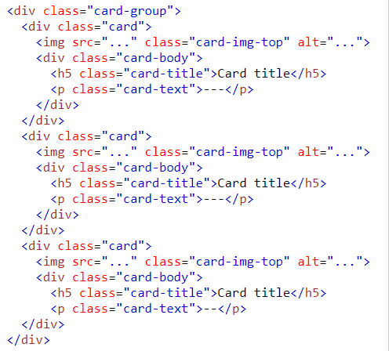
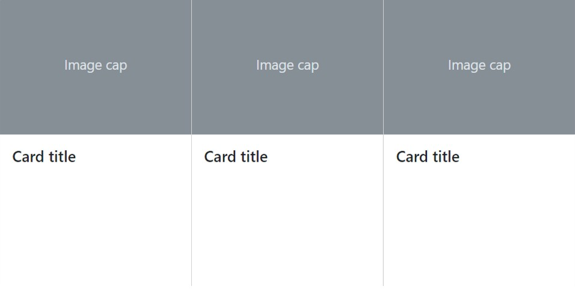
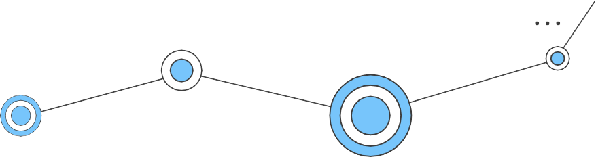
Card Layout
The card layout encompasses a variety of structures, allowing users to include images, headers, footers, lists, and other UI elements.

Slide 48
Quiz - 3
Describe the features of Bootstrap cards.

Slide 49
References
Books
Syed, M. A. (2020). Bootstrap 5 By Example. Packt Publishing.
Spurgeon, B. (2017). Learning Bootstrap 4, Second Edition. Packt Publishing.
Web Resources
Bootstrap Forms
Bootstrap Documentation. Forms. Available at: https://getbootstrap.com/docs/5.0/forms/overview/
Bootstrap Form Controls
Bootstrap Documentation. Form controls. Available at: https://getbootstrap.com/docs/5.0/forms/form-control/
Bootstrap Buttons
Bootstrap Documentation. Buttons. Available at: https://getbootstrap.com/docs/5.0/components/buttons/
Bootstrap Utilities
Bootstrap Documentation. Utilities. Available at: https://getbootstrap.com/docs/5.0/utilities/borders/
Bootstrap Cards
Bootstrap Documentation. Cards. Available at: https://getbootstrap.com/docs/5.0/components/card/

Slide 50
Topic 10 – Responsive CSS Framework Bootstrap -II
Any Questions?
Notes:
NCC Education - End Slide Master

